Slide 1
Feasibility of a Short-Term Virtual Reality Balance Intervention to Improve Mobility Smoothness in Parkinson' s Disease
Frontiers in Virtual Reality 2020

Slide 2
Introduction
1. Parkinson’s disease is one of the most common neurodegenerative disorders worldwide.
2. Gait training in the environment of the clinical setting may lack real-life challenges or novelty, reducing the transfer to real-life situations.
3. In VR-based rehabilitation, patients are immersed in interactive scenarios mimicking real-world environments, and this immersion may offer a more straightforward transfer from the rehabilitation to activities of daily living.
4. In this study, we report on the safety, feasibility, and efficacy of using a 5-weeks VR-based intervention in promoting changes in mobility smoothness in participants with PD.
5. We hypothesized that VR-based intervention focused on balance activity would improve the movement quality and non-motor performance of participants with PD.

Slide 3
Materials and methods
1. Participants
(1) 23 participants with PD were randomly assigned to either the intervention group (PD VR, n = 11) or the control group (PD control n = 12).
(2) Individuals with a previous history of other neurological or orthopedic diseases and severe vision deficits were excluded.
(3) All participants underwent two assessments: (1) pre-intervention (baseline), (2) post-intervention, after 5 weeks of control or VR-based intervention.

Slide 4
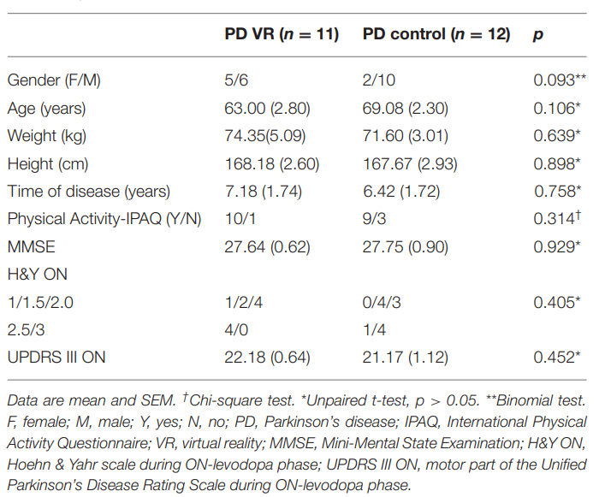
国际体力活动量表
帕金森病情分级量表
统一帕金森评定量表

Slide 5
Materials and methods
2. Measure assessment
(1) Mini-Mental State Examination (MMSE)
(2) State-Trait Anxiety Inventory (STAI)
(3) Rivermead Behavioral Memory Test, third edition (RBMT-3)
(4) Unified Parkinson’s Disease Rating Scale (UPDRS III)
(5) Hoehn & Yahr stage (H&Y)
(6) International Physical Activity Questionnaire (IPAQ)
(7) Timed Up and Go (TUG) (行走功能以及跌倒风险测试)
(8) 10m walking test (10MWT)

Slide 6
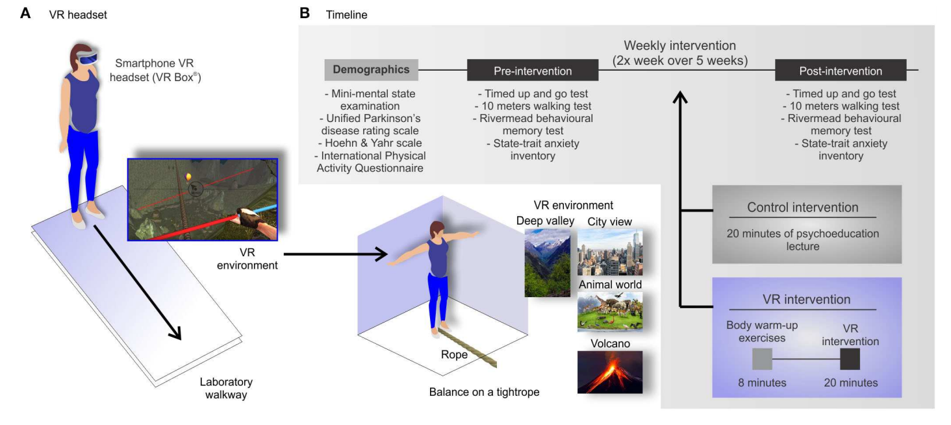
Materials and methods
3. Procedure
(1) The rope crossing in the virtual environment required participants to tilt head left and right during walking.
(2) Participants from the intervention group received 8 min of total body warm-up exercises and 20 min of VR training (in each session) twice a week for 5 weeks.

Slide 7
Results and discussion
1. VR-based intervention did not improve performance or movement quality in the TUG test.
2. Both groups walked faster at the post-intervention time point for the 10MWT.
3. For SPARC, VR participants presented greater smoothness compared to the control group.
4. We found moderate correlations between SPARC parameters and UPDRS III, H&Y, STAI, and RBMT-3.
5. SPARC during the 10MWT moderately correlated with cognitive function parameters (STAI, RBMT-3).
6. Limitations:
(1) The control group maintained their regular activities.
(2) The lack of measurement other than questionnaires to better distinguish
motor impairments and PD participants.
(3) The sample size.

Slide 8
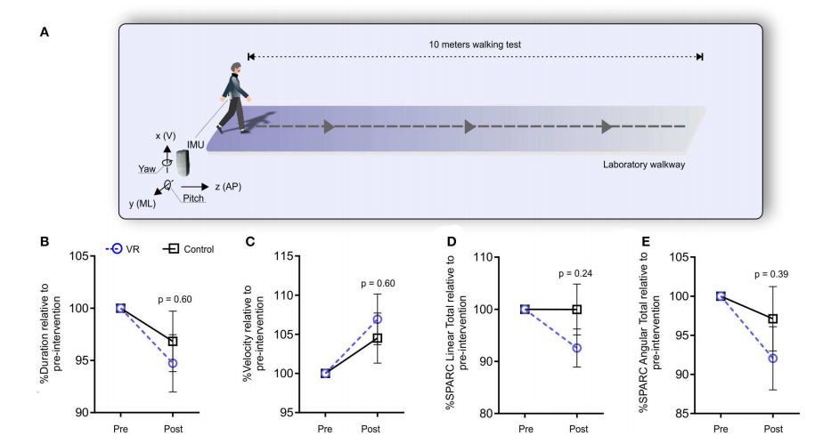

Slide 9
Conclusion
1. A short-term VR-based balance training is a safe and feasible intervention but did not improve movement quality and cognitive function in participants with PD。
2. SPARC is a reliable measurement to estimate mobility smoothness, and it correlated with motor and non-motor clinical assessments.

